Slide 1

Reconciling Global and Local Needs A canonical research project to deal with workarounds
Surshita Cheripalli
Garima Anand

Slide 2


Agenda
Introduction
Research details
Strengths
Weaknesses
Proposal

Slide 3
Introduction
Research Question How can requirements of MNC HQ for standardized worldwide processes (top-down) be reconciled with local requirements expressed by users (bottom-up)?
Julien Malaurent conducted a 3-year case study (2007-2011) at Chinese joint ventures of a French multinational
Uncovering workarounds implemented by Chinese subsidiaries that surprised the headquarters.
This led to a joint effort to perform Canonical Action Research to balance standardized ERP processes with local needs.
Notes:
Action research is a method that solves real-world problems while also contributing to theoretical knowledge.
Action Researchers are directly involved in changes made in Organization to understand the impact and reflect on the learnings to make scholars aware of the theoretical understanding.
This makes it different from case studies which are more observational without much involvement.

Slide 4
Research Setting
Focal Organization | Chinese Subsidiaries of French Multinational Company in Nuclear Power Industry
Data | 12 Units split into 38 Plants and 670 Users
Duration | 1 Year Action Research project 2010(Backed by 3 Years Case Study by researcher 2007-2011 )
Team | 3 Functional experts , 3 ERP technical Experts 2 Joint Project Leaders 1 Academic researcher who studied diffusion of global ERP
Location | Local Asia Pacific Head office ( Shanghai )

Slide 5
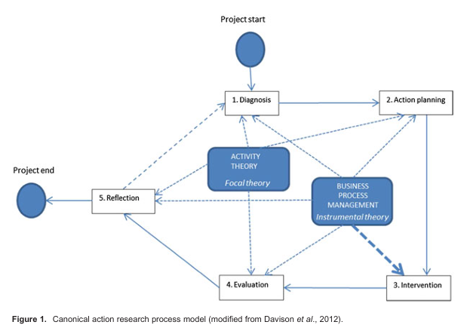
Research Process Model
Research Method | Canonical Action Research Practical problem solving with theoretical relevance
Focal Theory | Activity Theory The intellectual basis influencing and guiding the research scope of the AR project
Instrumental Theory | Business Process Management Include tools, processes, or models that theorize how work is done and how outcomes are achieved

Slide 6






1 Year 1 Cycle CAR Project
64 Work arounds identified
Diagnosis
Action Planning
Embracing workaround practices ,by formal agreement on mission statement
Intervention
Identifying users to work with managers to decide whether to formalize workarounds or prevent them
Evaluation
Comparison of pre intervention and post intervention states
21 formalized 28 prevented 15 informal workarounds
Reflection
Insufficient contract duration
Activity theory principles were difficult to communicate among practitioners
Notes:
Only 9 moths of intervention period was too short , and hence 13 workarounds were still remained as informal workarounds without any significant intervention

Slide 7
Addressing Workarounds
Parallel-System Workaround | Data Adjustment Workaround | Process Adjustment Workaround
It creates separate, often informal, systems | It modifies data with non-standard data within the ERP system | modifications to existing company processes
Cause - Taxation system | Cause – Cost allocation | Cause - Guanxi
Action- Users entering data into both the ERP system and other legacy systems to fulfill local taxation requirements. | Action- controlling policies for displaying statistical key figures for cost allocation were different within chinese subsidiaries and western orgs | Action- nurturing personnel relationship with customers which are out of standards set by french multinational
Notes:
Identified and adressed - Three types of workarounds
Parallel-system – alternate system, bypass official ERP, cause – Taxation
Data adjustment – modifies data, cause - cost allocation, rules and pro
Process adjustment – modifies existing process, Guanxi, improve customer relationship, by informal communication, not the standards set by the organization
Parallel-System Workaround - Using alternate systems to bypass the official ERP..
Cause - taxation, Action - Action : Users entering data into both the ERP system and other legacy systems to fulfill local requirements.
Data Adjustment Workaround – action - users modify data within the ERP system to meet local requirements
Cause – cost allocation - It means that the rules and procedures for how statistical key figures are used to allocate costs within a company are not the same in Chinese State-owned Enterprise (SOEs) as they are in Western companies.
Cause : Controlling policies for Statistical key figures for cost allocation is different in Chinese state- owned enterprise to that of western
Action : Users entered inaccurate or non-standard data into the ERP system to meet local needs.
Process Adjustment Workaround
Cause : Sales personnel nurturing relationship with customers following Chinese cultural practices
Action : Users modified organizational procedures, using empty fields and creating additional processes to fit their requirements.

Slide 8
Strengths of Research
Canonical Action Research – combines activity theory with BPM processes
Diverse Team – Collaboration between researcher and practitioners
Win-Win Situation – both headquarters and chinese subsidiary satisfied by outcome
Practical Impact – 49 out of 64 workarounds addressed
Notes:
Greatest pillars of this research -
This research used - Canonical Action Research
Not only theoretical analysis , but also implementing remedial actions to resolve the issues and reflecting on the impact of the changes.
The CAR approach, combined with activity theory and BPM, proved effective in dealing with workarounds and improving the ERP system post-implementation.
Diverse Team
Collaboration between Researchers and Practitioners gave all round understanding of Processes and theoretical concepts.
Win-Win Situation
Both Headquarter and local Chinese users were satisfied by the outcomes
Reinstated trust between headquarter and Chinese subsidiary
Practical Impact
The interventions addressed 49 out of 64 workarounds, aligning global ERP systems with local needs.

Slide 9
Weaknesses of Research
Bounded Timeline – one-year timeline, 15 workarounds unresolved
and
Cultural Challenges – Guanxi – informal communications
Scalability and Generalization
Activity theory difficult to comprehend
Notes:
Bounded Timeline
A one-year timeline, constrained by organizational changes and PhD commitments, left 15 workarounds unresolved.
Activity theory difficult to comprehend
BPM was easily applied by practitioners, but activity theory was more difficult to communicate and understand.
Cultural Challenges
Local cultural practices like ‘Gnauxi ‘need to be emphasized more while analyzing business processes.
Scalability and Generalization
Only one geographic location (China) was analyzed in the research , Similar issues could exist in other subsidiaries

Slide 10

Extend the timeline for deeper cultural insights and to resolve workarounds.
Proposal
Global Integration
Training Practitioners
Notes:
Another cycle with extended intervention period to understand cultural aspects and formalize remaining workarounds
Global Integration : Learning should be integrated across organization to reduce local workarounds in various other subsidiaries
Training Practitioners - create better understanding on activity theory

Slide 11
Utilizing futuristic technologies
Notes:
API and Webservices , along with custom modules based on local needs

Slide 12



Thank You

